Slide 1
Data Warehouse Design, Development and Analysis of a Hospital Performance for InPatient and OutPatient
Presented by: Data Biryani (Team-6)
Shashikanth Dhanekula (Captain)
Akash Bansal
Hariprasanth Palanisamy
Vaishnavi Shetty

Slide 2
Motivation
Hospitals play an integral role in the U.S economic system and they are the most important part of the society.
In 2019 an average individual in US is spending almost $5,000 for medicare. Usually medical benefits varies from state to state. Hence this gives us the motivation to select this dataset and work on to provide useful insights.
We have considered hospital Inpatient, Outpatient and payment measure data sets from 2015-2017.

Slide 3
Objectives
Our main aim of our project is to Design and develop the Data Warehouse and to analyze the hospital performance by state level in USA over period of 3 years to achieve following objectives:
To Analyze the cost involved in inpatient medical procedures classified by DRG definition by medical providers across the USA.
To Analyze the cost involved in outpatient medical procedures classified by APC definition by medical providers across the USA.
To breakdown different Ambulatory Payment Classification (APC) procedure codes with respective Healthcare Common Procedure Coding System (HCPCS) procedures to achieve granular cost break down for outpatients.
To measure hospital performances by comparing outpatient medical costs against national average

Slide 4
Implementation Plan
Design Phase
Create a Conceptual Model.
Show the High level Data flow in the Data Warehouse
Data Profiling
Development of Data Warehouse
Create a physical model of the dimensional model.
Load tables into staging and transform.
Load data into star schema tables.
Reporting
Analyze data using Sql queries.
Import the data into tableau for analysis.
Create dashboards.
Present the Insights.

Slide 5
Data Description
Data sets used for this project are from 2015 - 2017 involving 4 different data sources. They are as follows:
Hospital Payment and Performance.
Medicare outpatients HCPCS/APC.
Medicare inpatients.
Medicare outpatients by APC.

Slide 6

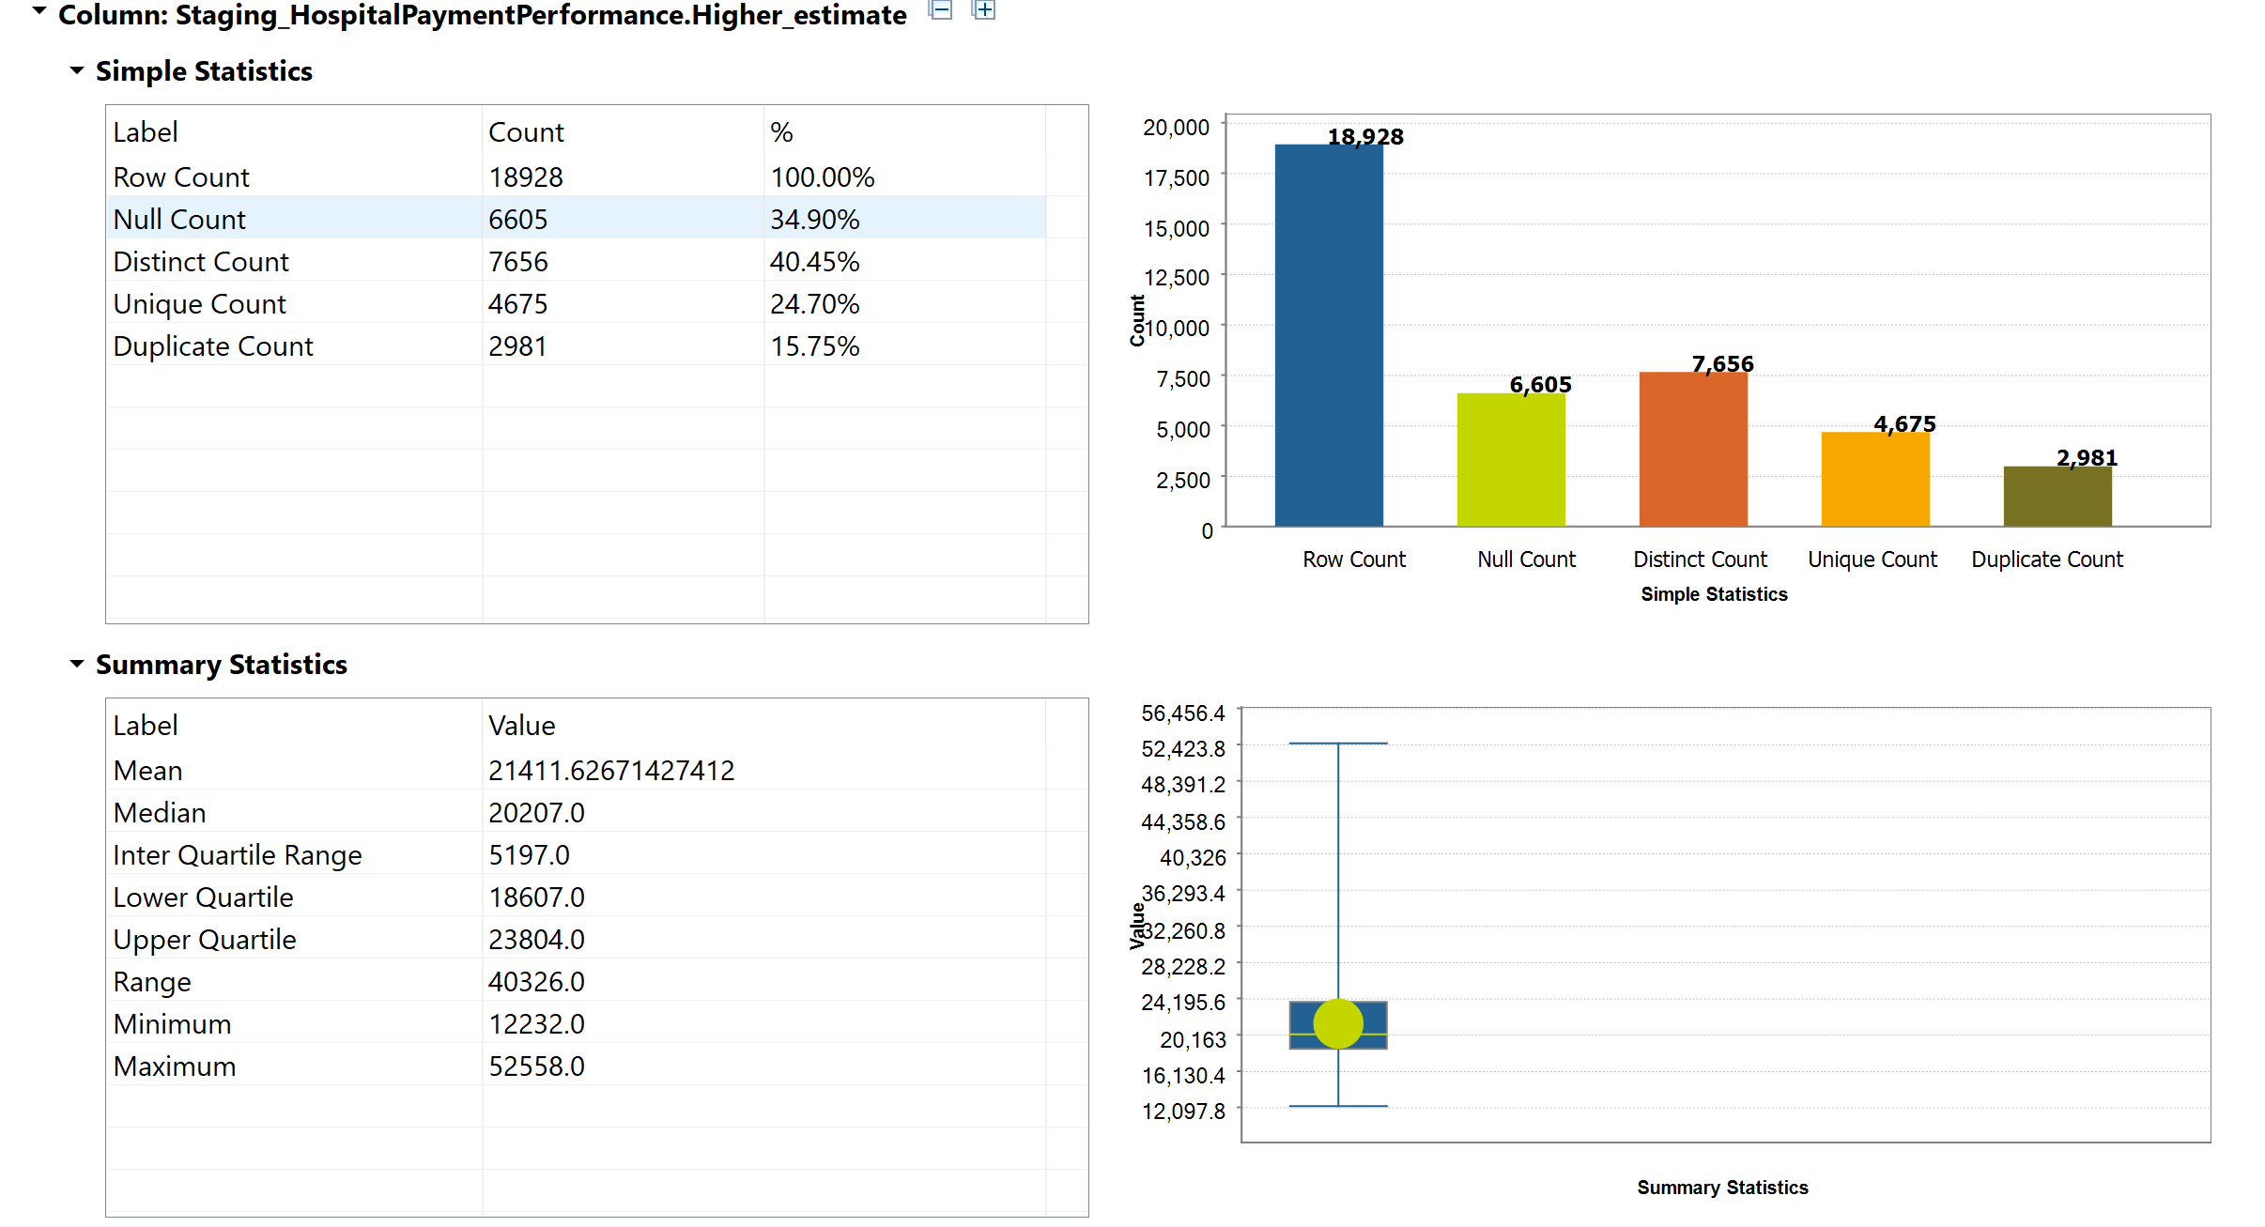
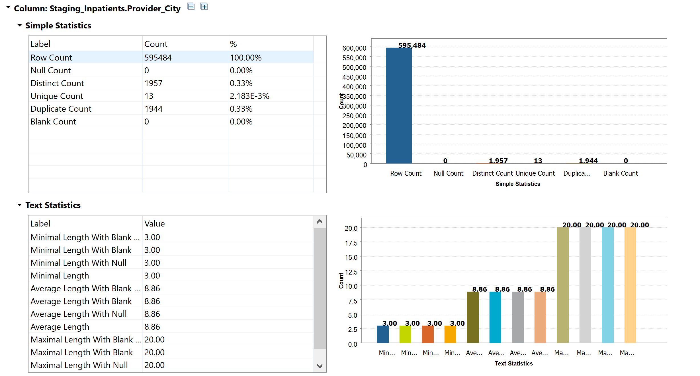
Data Profiling
Notes:
Data profiling is the process of reviewing source data, understanding structure, content and interrelationships, and identifying potential for data projects which is important before proceeding for analysis and gaining insights.
So, here is the data profiling analysis for Inpatients and Hospital Payment Performance from which we can analyse the null values,the average values and length for each field which is used in building the Staging Table and cleaning the Data Source too.

Slide 7
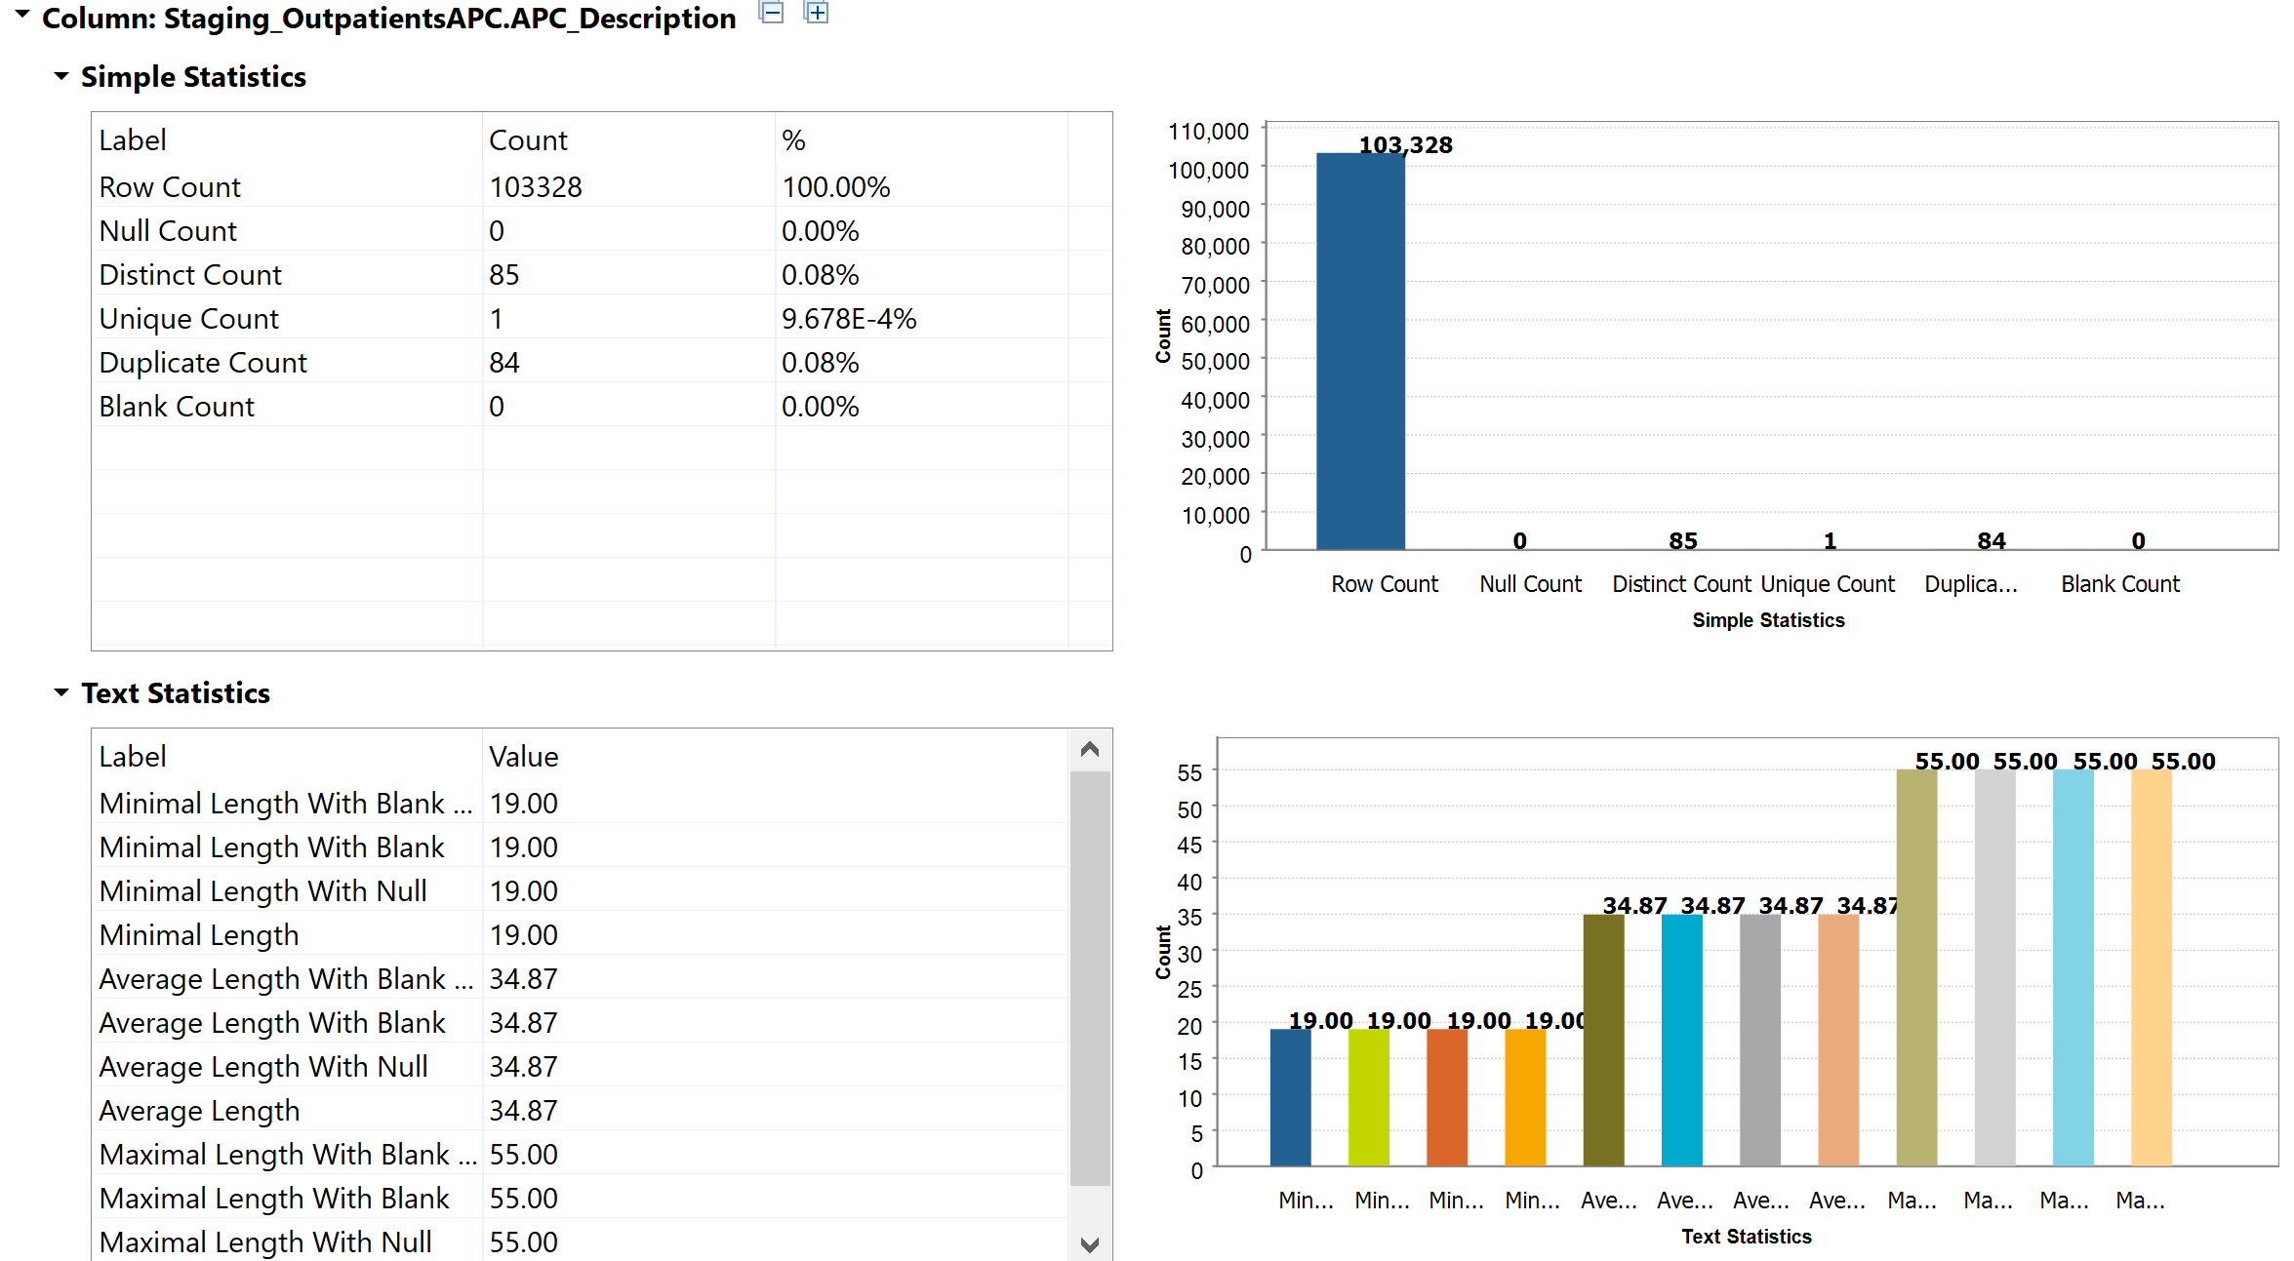
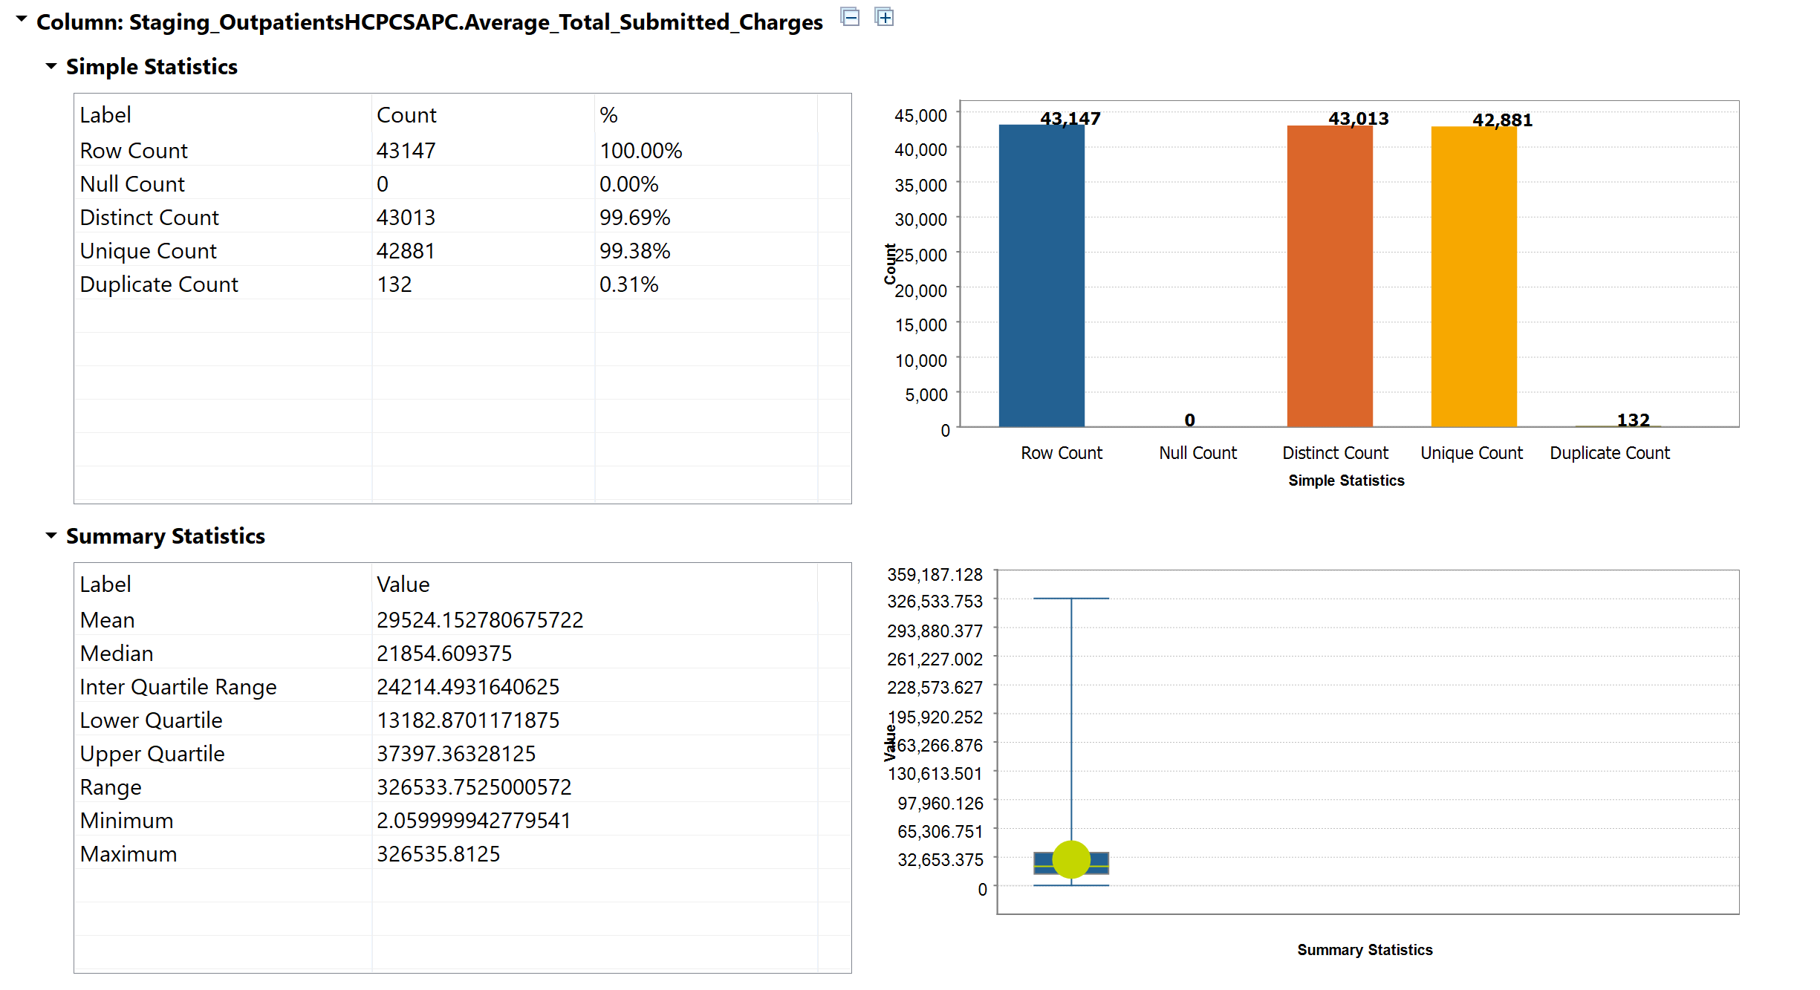
Notes:
Data profiling analysis for Outpatients APC and Outpatients HCPCS,APC from which we can analyze the number of null values, the average values and length for each field which is used in building the Staging Table and cleaning the data source.

Slide 8
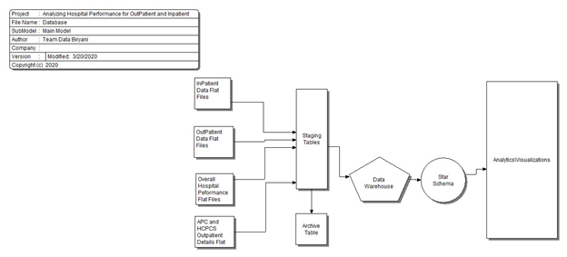
High level Data flow in the Data Warehouse
Notes:
4 flat files into 4 staging table and archive tables , data conversion happens in this stage then implement SCD and load into final stg/ loading tables . then from there to respective fact and dimension tables

Slide 9
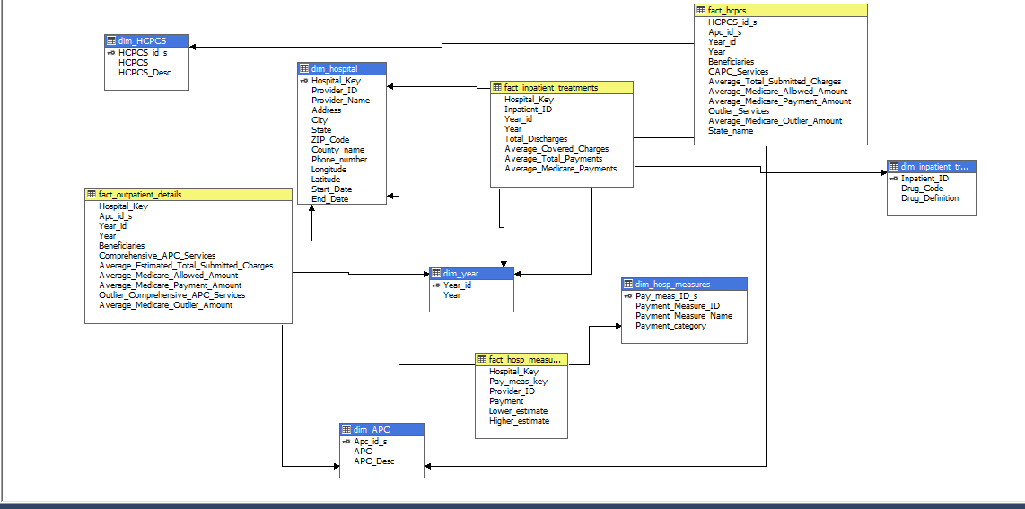
Schema of a Dimensional Model
Notes:
Schema was created after creating OLAP cubes using visual Studio SSDT and sql server analysis package

Slide 10
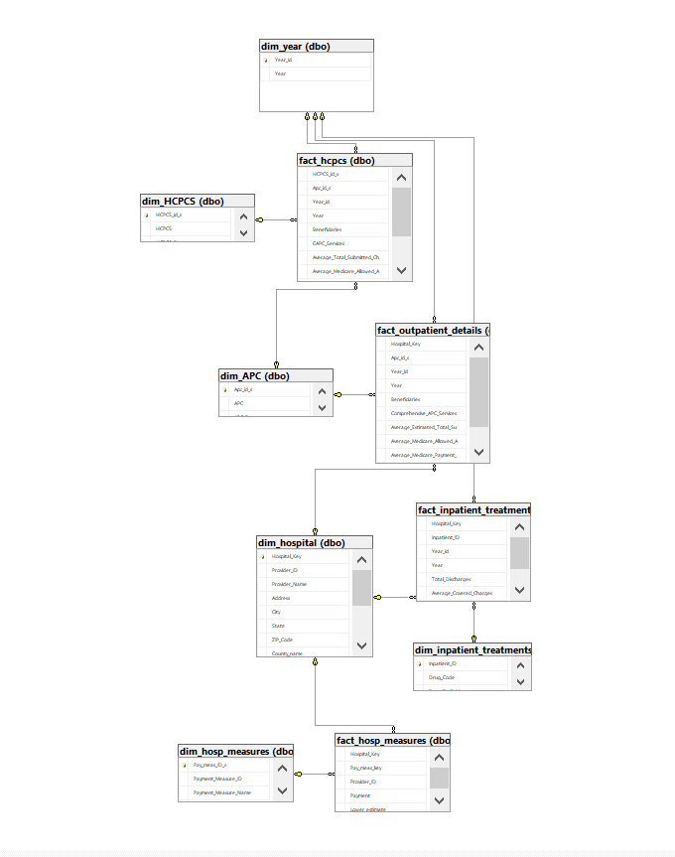
Entity Relationship Diagram
Notes:
ERD was created in SQL after making primary and foreign key relationship between fact and dimension tables

Slide 11

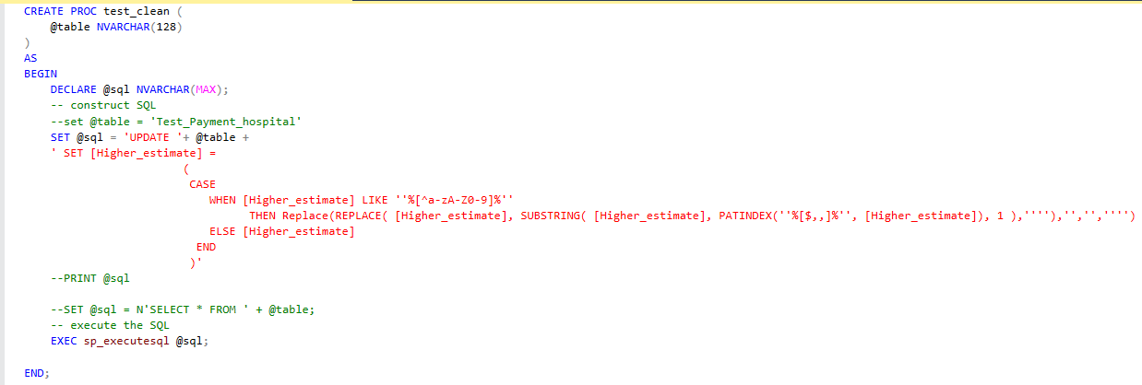
Data cleaning
Notes:
We have created a stored procedure to remove special characters and blank spaces from the tables

Slide 12
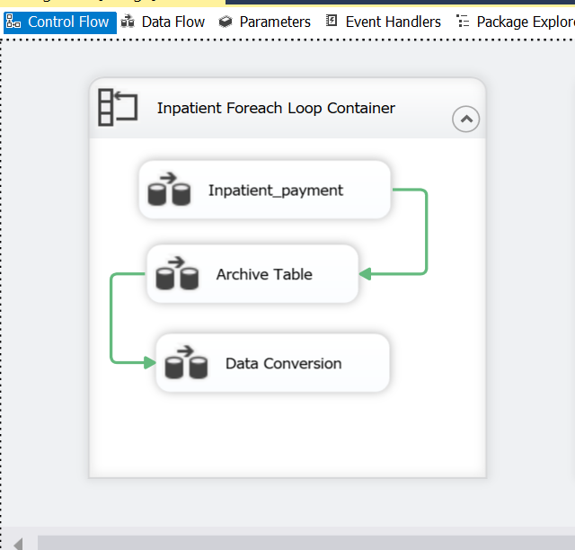
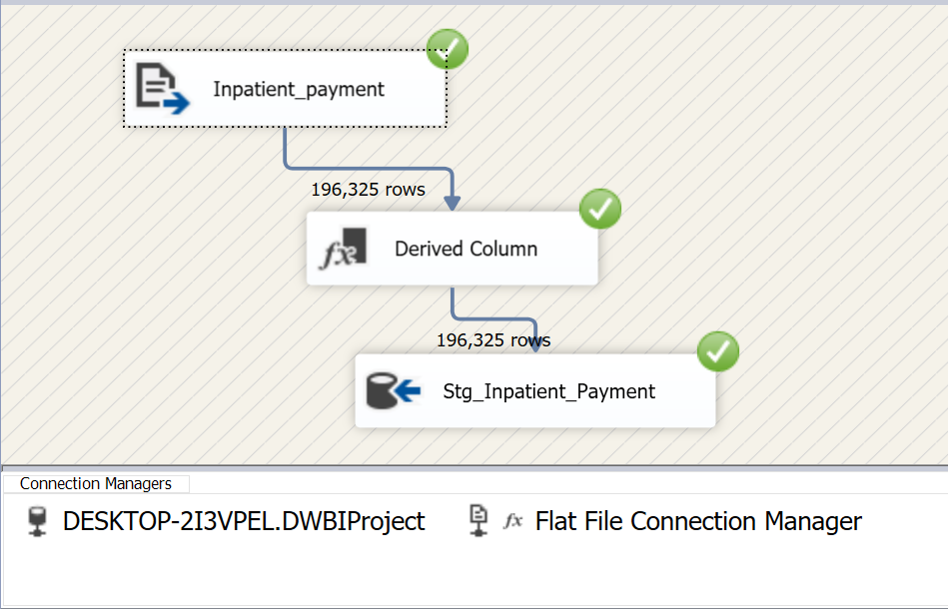
Data loading from Source to Schema
Notes:
Using foreach loop we have loaded the data into master tables.
Using SSIS we have imported the data into staging tables. Using derived column function we have added an Year column in the staging dataset.

Slide 13
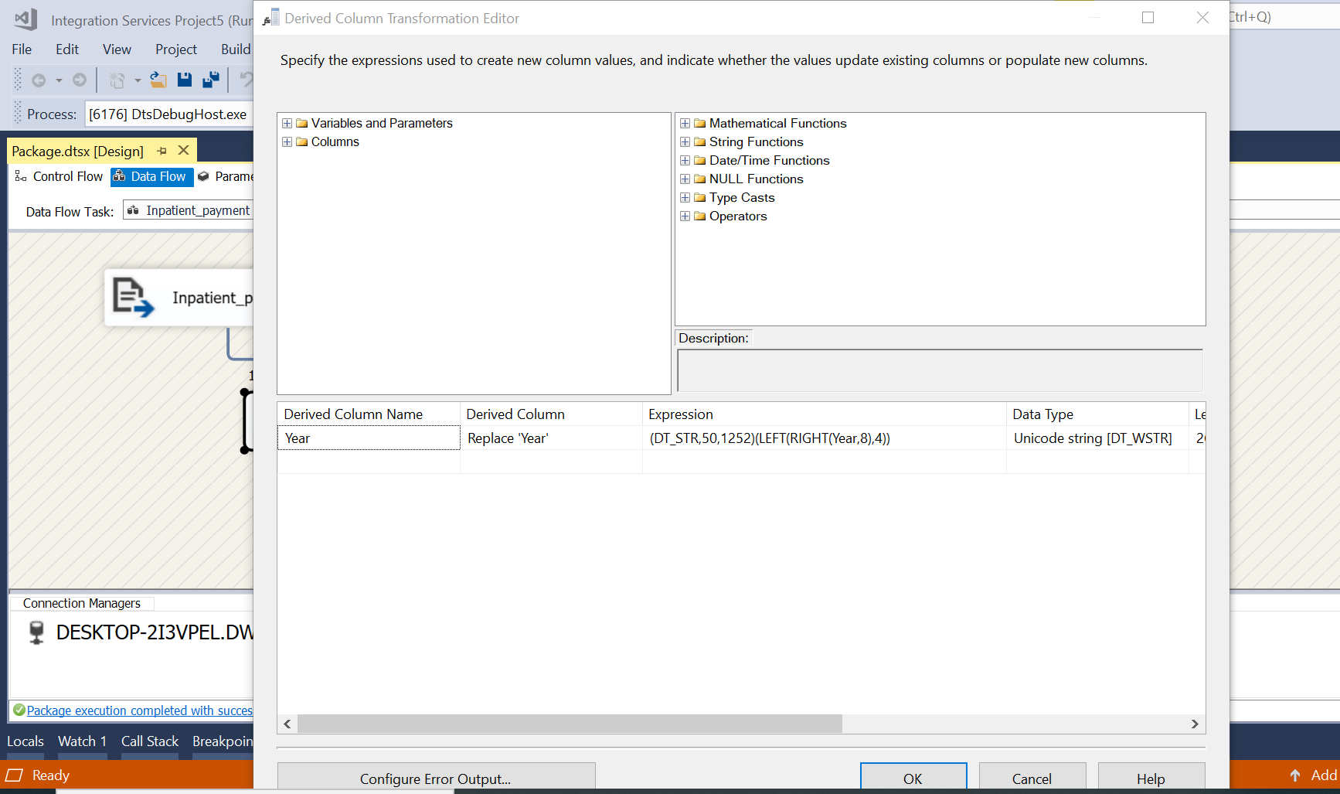
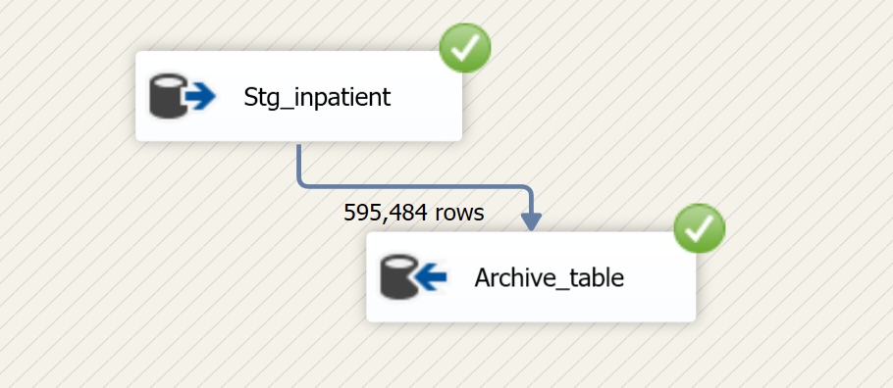
Notes:
Next from staging table we loaded the data into archive table.

Slide 14
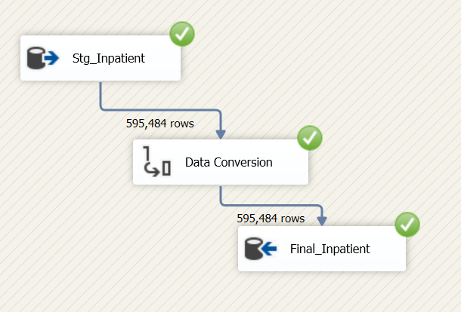
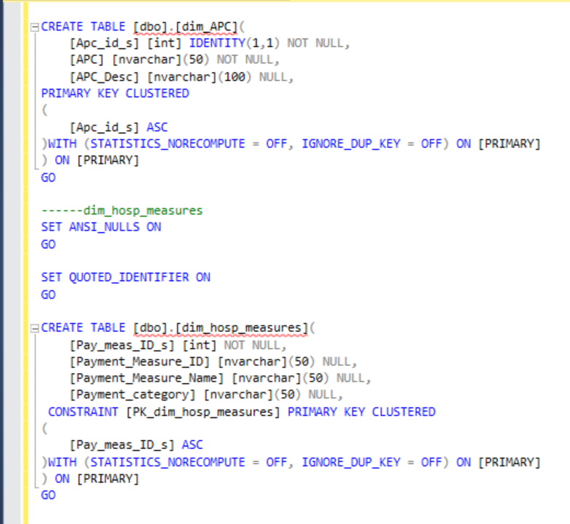
Notes:
Data

Slide 15
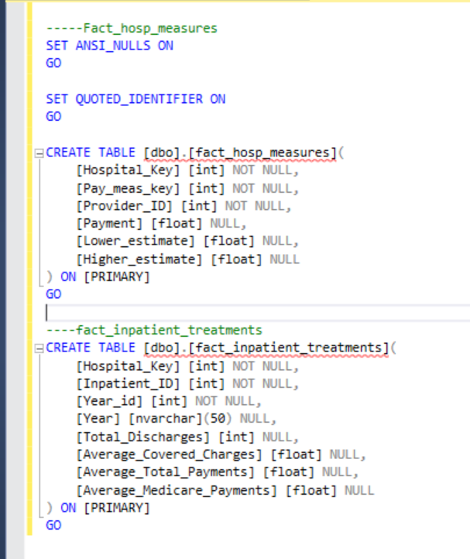
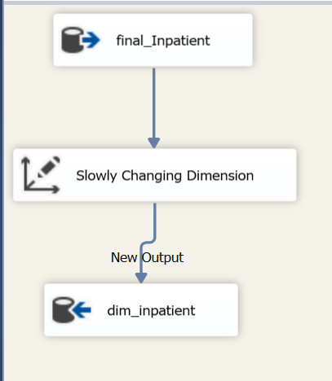

Slide 16
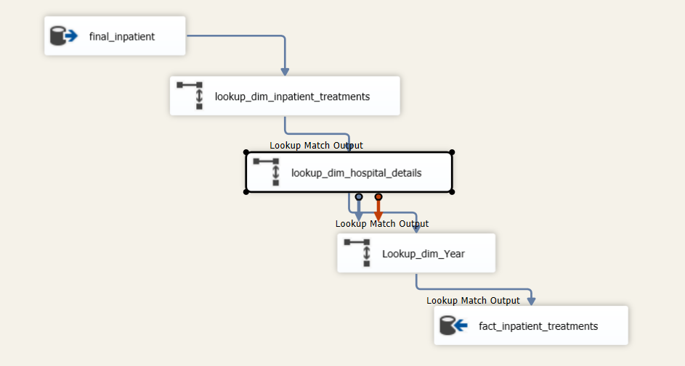
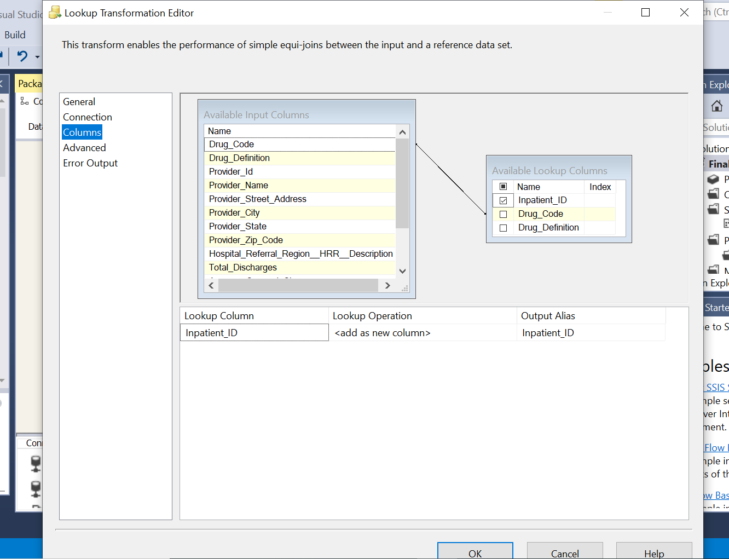

Slide 17

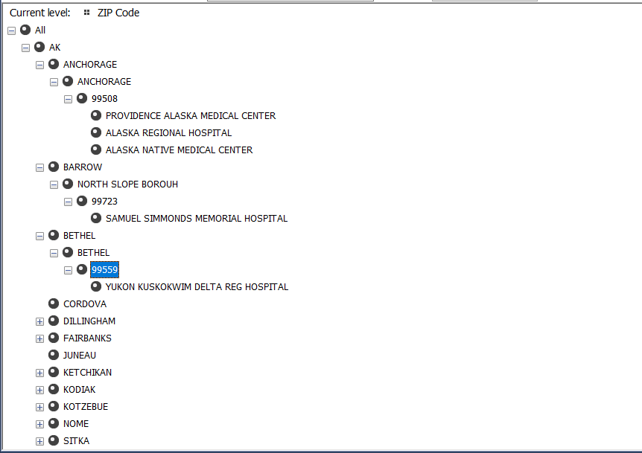
OLAP Cube
Notes:
After creating OLAP cube using Sql server analysis services -
Created Hierarchy for Hospital address to get insight by levels state -> city -> county -> zip code -> hospitals

Slide 18
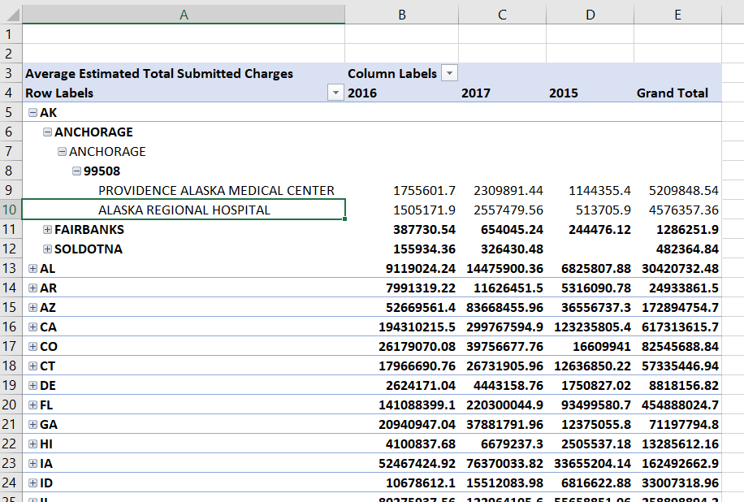
Notes:
After processing all dimensions , i.e changing ID’s to id name for proper view
Then cube is processed
Then it is viewed using excel pivot table for analysis

Slide 19
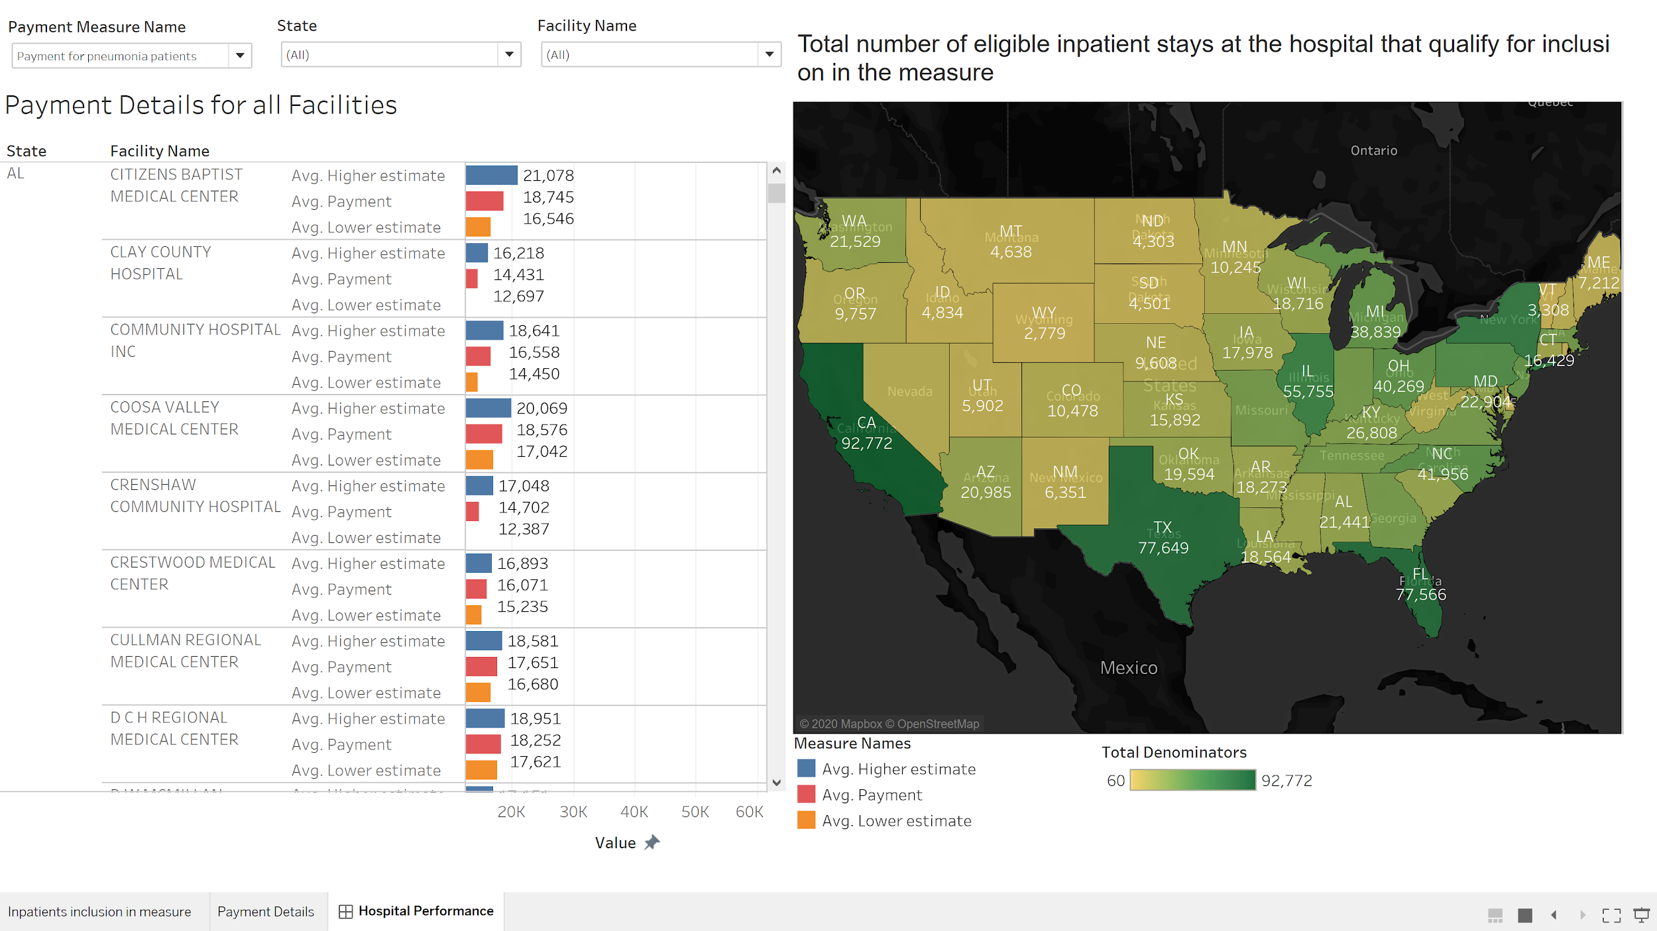
Data Reporting and Visualizations

Slide 20
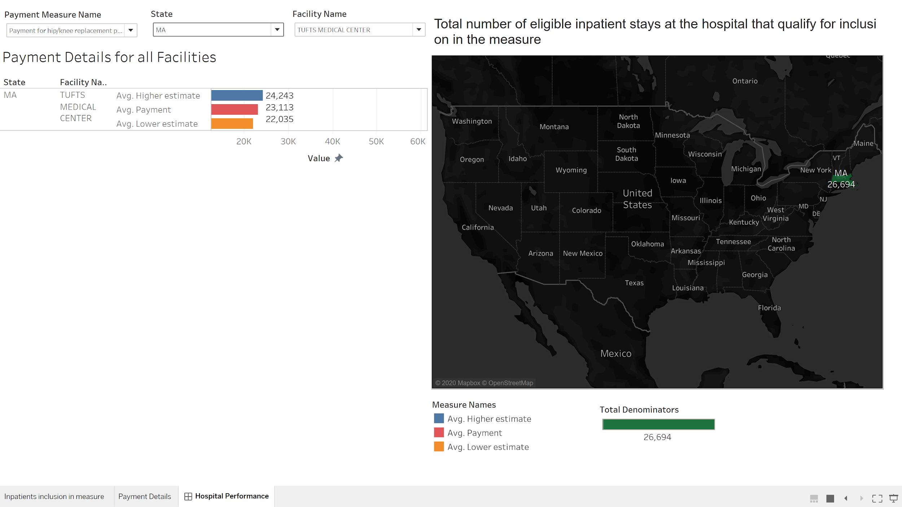

Slide 21
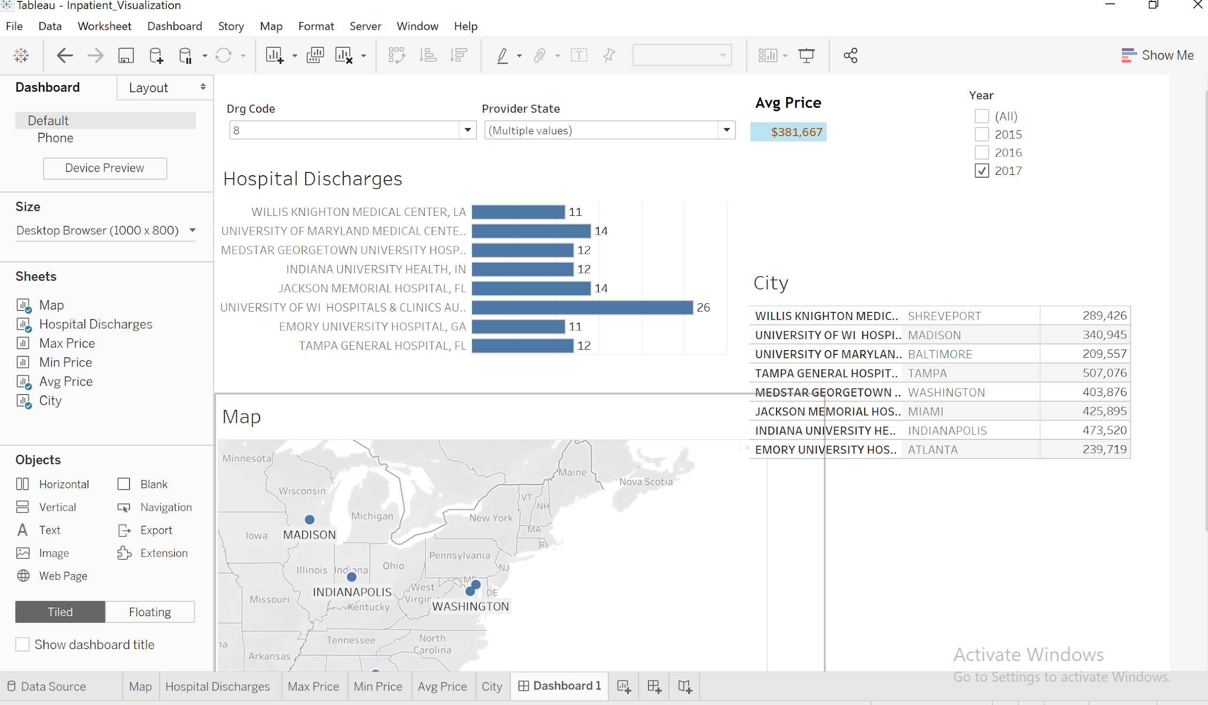

Slide 22
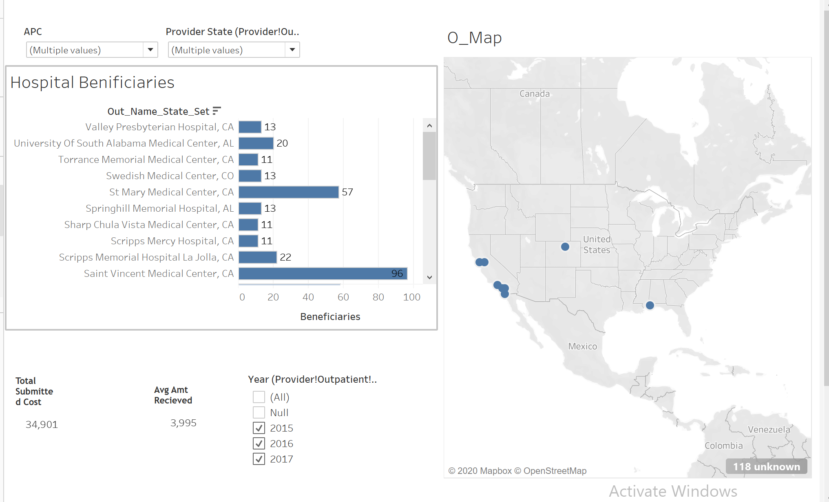

Slide 23

THANK YOU

